Slide 1
Android Content Provider

Slide 2
Content Provider
A content provider manages access to a central repository of data.
Content providers are primarily intended to be used by other applications
Typically you work with content providers in one of two scenarios;
You may want to implement code to access an existing content provider in another application.
You may want to create a new content provider in your application to share data with other applications

Slide 3
Content Providers usages
The API you use to retrieve data from a content provider.
The API you use to insert, update, or delete data in a content provider.

Slide 4
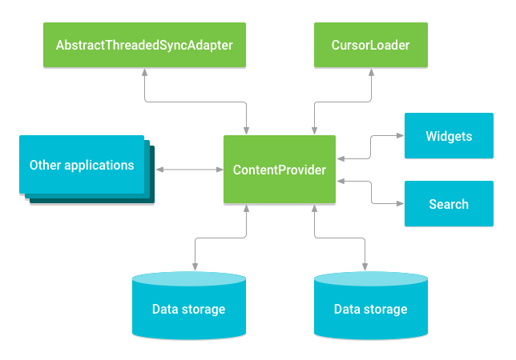
Overview
A content provider coordinates access to the data storage layer in your application for a number of different

Slide 5
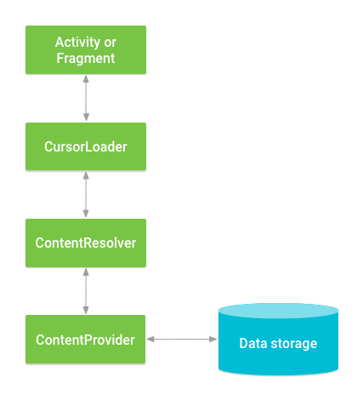
Interaction between ContentProvider, other classes, and storage

Slide 6
Important Apis
ContentResolver - used to work with already created provider to select, add, update or delete data
ContentProvider – used to create new provider

Slide 7
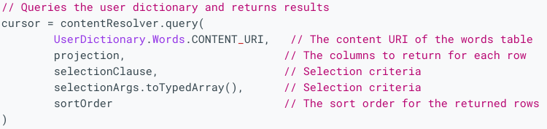
Content Resolver - Code

Slide 8
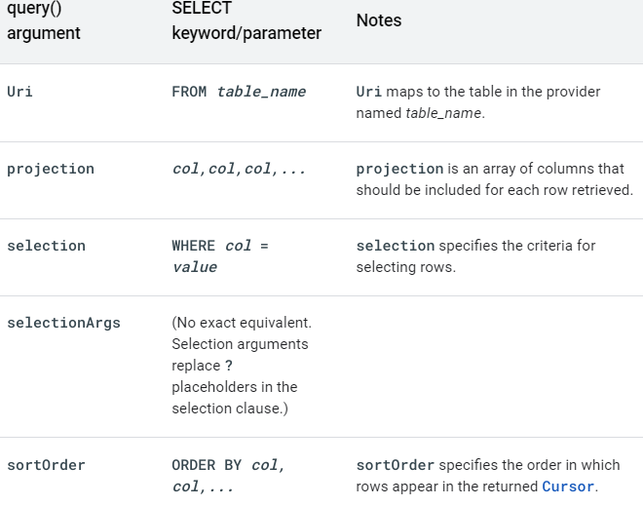
Content Resolver – Query Parameters

Slide 9
Creating a content Provider
Decide if you need a content provider
You want to offer complex data or files to other applications.
You want to allow users to copy complex data from your app into other apps.
You want to provide custom search suggestions using the search framework.
You want to expose your application data to widgets.

Slide 10
Steps to work with content provider
Create a class in the same directory where the that MainActivity file resides and this class must extend the ContentProvider base class.
To access the content, define a content provider URI address.
Create a database to store the application data.
Implement the six abstract methods of ContentProvider class.
Register the content provider in AndroidManifest.xml file using <provider> tag.

Slide 11
Designing content URIs
content:// – Mandatory part of the URI as it represents that the given URI is a Content URI.
authority – Signifies the name of the content provider like contacts, browser, etc. This part must be unique for every content provider.
optionalPath – Specifies the type of data provided by the content provider. It is essential as this part helps content providers to support different types of data that are not related to each other like audio and video files.
optionalID – It is a numeric value that is used when there is a need to access a particular record.

Slide 12
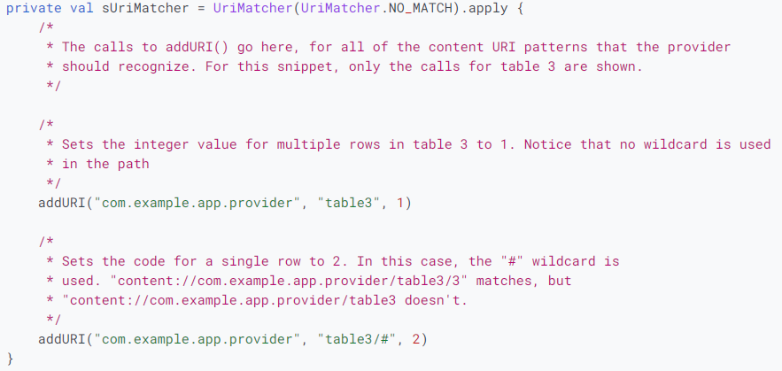
Content URI patterns
To help you choose which action to take for an incoming content URI, the provider API includes the convenience class UriMatcher

Slide 13
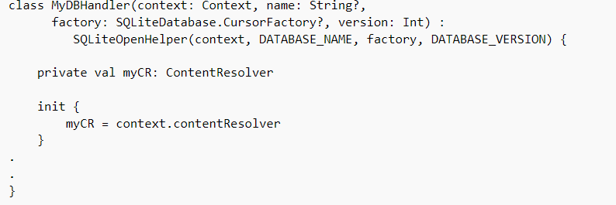
Creating a DB

Slide 14
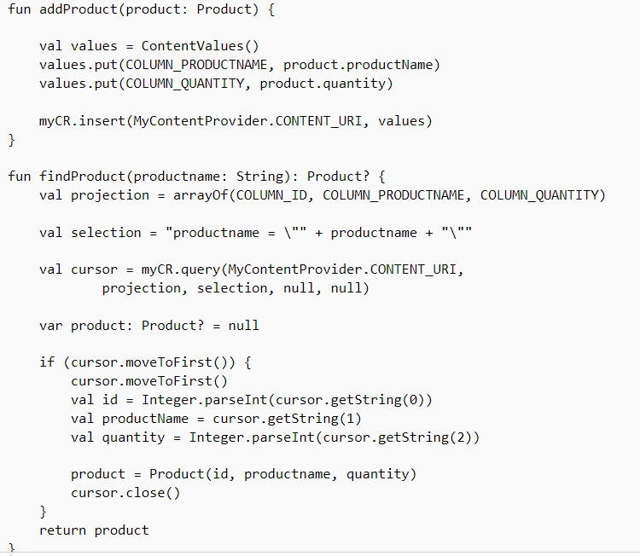
Creating DB

Slide 15
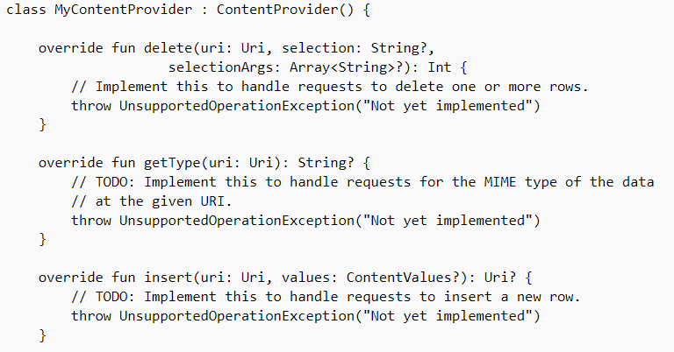
Sample Provider - Code

Slide 16
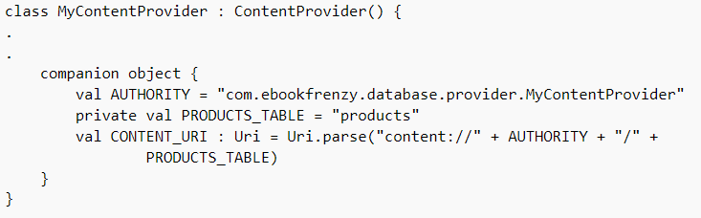
Creating Authority – Sample Authority

Slide 17
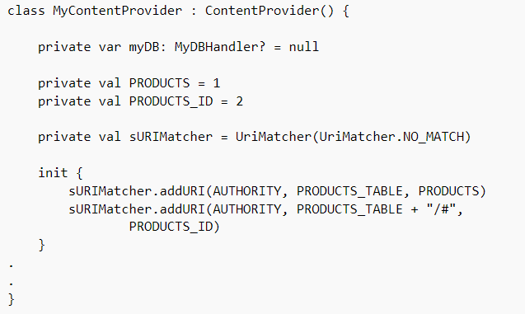
Creating URI Matcher

Slide 18
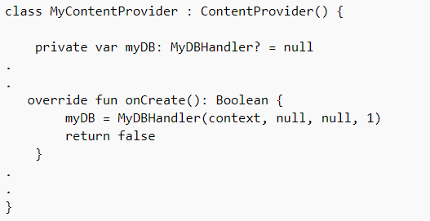
Implementing the Content Provider onCreate() Method

Slide 19
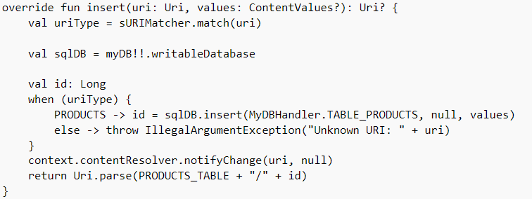
﻿Implementing the Content Provider insert() Method

Slide 20
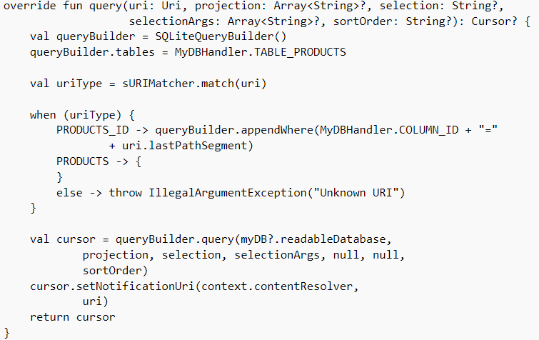
﻿Implementing the Content Provider query() Method

